Slide 1
Analysis of Citibike Service
A detailed look at how New Yorkers use their bike sharing service

Slide 2
Background
Signature project in NYC
Go Green
Improve street traffic
Healthier lifestyle
Started in May of 2013
~10,000 bikes, ~600 bike stations
10 million trips in 2015
Service expanded over the years
https://www.citibikenyc.com/

Slide 3
Emerging issues as the service expands
Operation more complex with larger service
Allocation of resources (e.g bikes, stations)
Redistribution of bikes
Maintenance of bikes and its timings
Maintaining bike availability at every station
Increased cost associated with expansion
Increased cost for customers
Cost increase from increased inefficiency in operation

Slide 4
Learn about ridership to improve operation
Goals of my analysis
Understand the basic trends in Citibike usage
Understand factors that affect the usage at specific locations
Understanding the differential patterns of usage among riders
Predicting bike usage at specific locations

Slide 5
The dataset
All the data used here were publicly available from the following sites:
Ridership data available from Citibike (https://www.citibikenyc.com/system-data)
Weather Data obtained from National Center for Environmental Information (https://www.ncdc.noaa.gov/cdo-web/)
Geolocation data for subway stations, museums, schools, and theaters were obtained from NYC Open Data (https://opendata.cityofnewyork.us/)

Slide 6
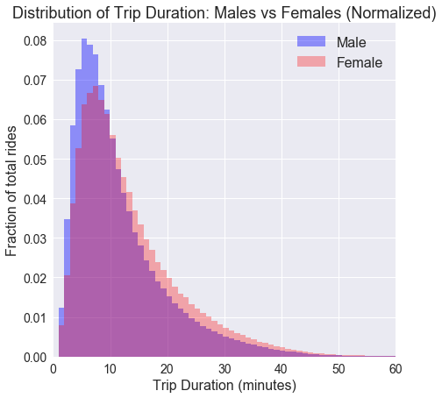
Exploratory
Data Analysis
Basic Findings
on the Ridership Patterns

Slide 7
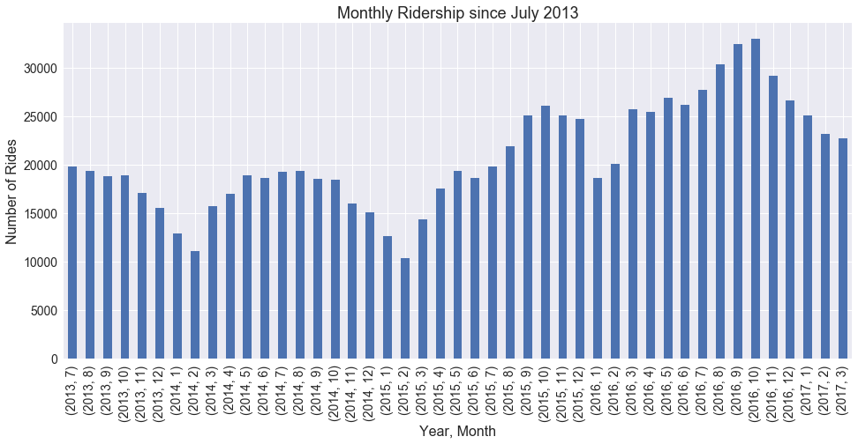
Overall ridership expansion and seasonal variations
Higher ridership in summer, much less in the winter

Slide 8
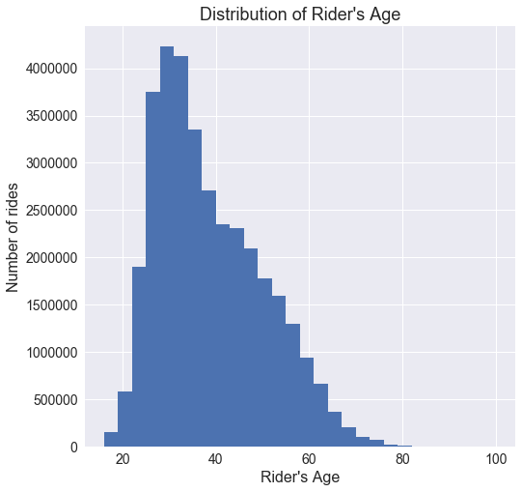
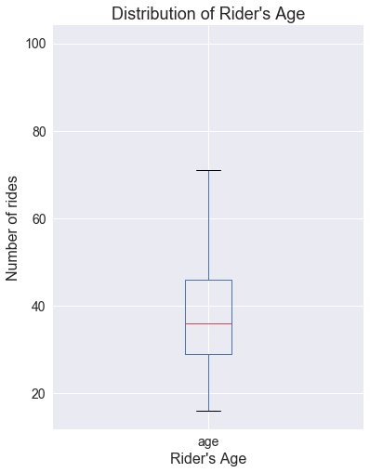
Demographics
Average age of 36
Biggest usage among people in 30s and 40s
74% males, 23% females (rest is unknown)

Slide 9
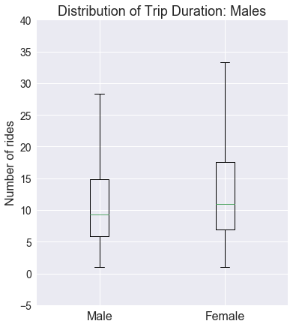
Ladies v.s. Gentlemen: Trip Duration Differences
Female rides tend to be male rides

Slide 10
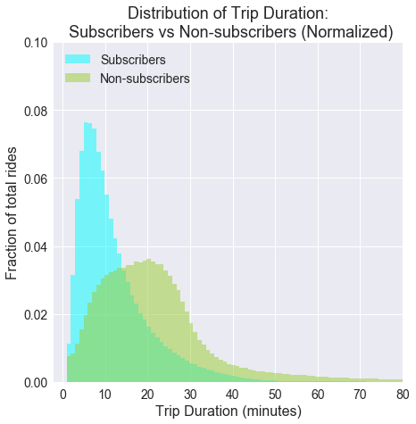
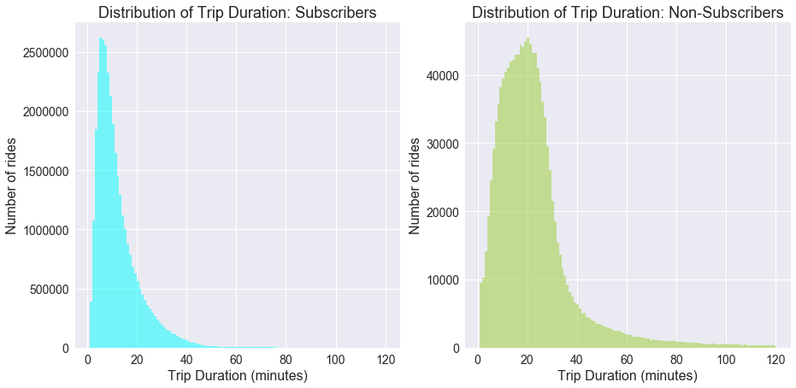
New Yorkers v.s. Visitors : Trip Durations
Non-subscribers (likely visitors) has significantly higher trip durations

Slide 11
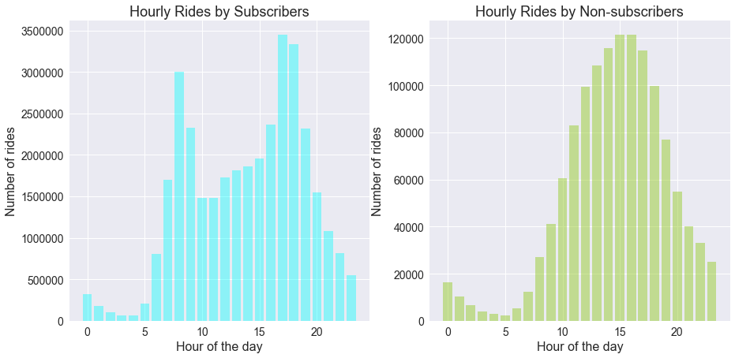
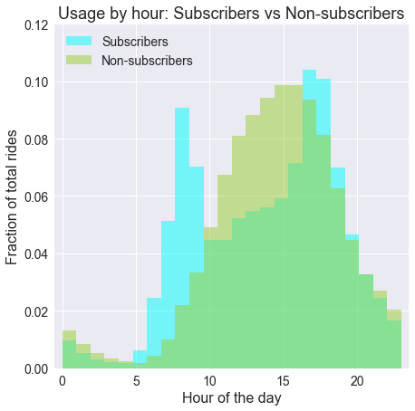
New Yorkers v.s. Visitors : Peak Hours
Subscribers (likely NYers) use the service for commuting, non-subscribers for exploring (?)

Slide 12
New Yorkers v.s. Visitors : Popular Stations
Rank | Station Name | Ave. Daily Pickups
1 | Pershing Square N | 292.7
2 | 8 Ave & W 31 St | 247.2
3 | Cooper Square & E 7 St | 238.6
4 | E 17 St & Broadway | 222.7
5 | W 21 St & 6 Ave | 222.2
6 | Lafayette St & E 8 St | 220.0
7 | Penn Station Valet | 214.7
8 | Broadway & E 22 St | 189.06
9 | Broadway & E 14 St | 187.2
10 | 8 Ave & W 31 St | 184.2
Rank | Station Name | Ave. Daily Pickups
1 | Central Park S & 6 Ave | 90.0
2 | Centre St & Chambers St | 66.8
3 | 5 Ave & E 78 St | 60.1
4 | Grand Army Plaza & Central Park S | 59.5
5 | 5 Ave & E 73 St | 56.4
6 | 5 Ave & E 88 St | 55.8
7 | Central Park West & W 72 St | 52.8
8 | West St & Chambers St | 51.8
9 | 12 Ave & W 40 St | 49.7
10 | Central Park West & W 85 St | 44.2
Apparent Pattern: Commuting v.s. Exploring the City

Slide 13
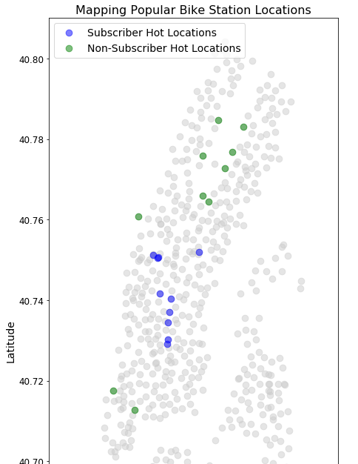
Difference is more obvious on a map!
Green: Popular stations among non-subscribers (visitors) are touristic locations, especially around Central Park.
Blue: Popular stations among subscribers (New Yorkers) are transportation hubs and main locations in the city

Slide 14
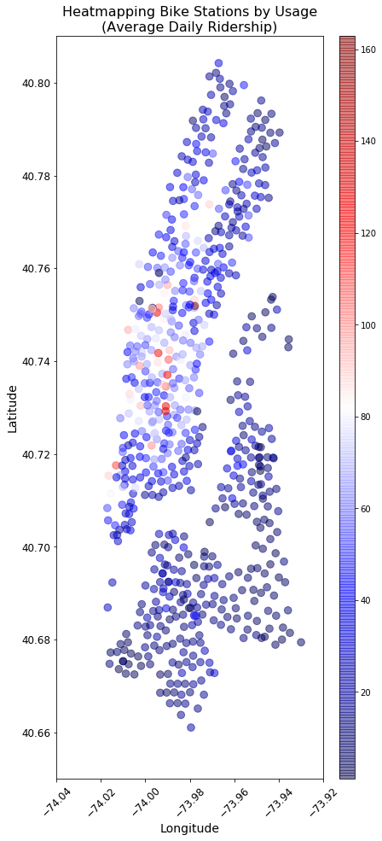
Factors that Affect the Ridership
What seems to affect the service usage?

Slide 15
Location, location, location
The heatmap on the right shows ridership by location
High ridership is concentrated in the central Manhattan.
Ridership is lower in uptown, in Queens, and in Brooklyn

Slide 16
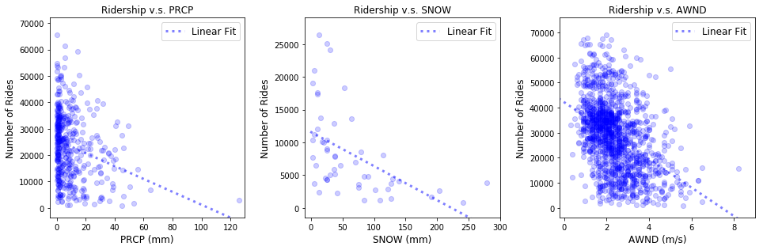
Weather Matters, even for New Yorkers
Rain
Snow
Wind
The better the weather, the higher the ridership (more or less)

Slide 17
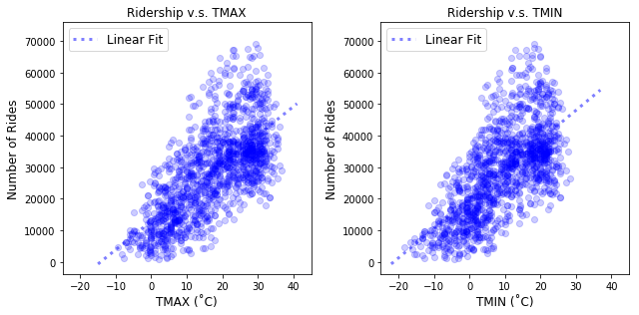
Temperatures Matter Even More
Highest Temp. of the Day (˚C)
Lowest Temp. of the Day (˚C)
The higher the temperature, the higher the ridership

Slide 18
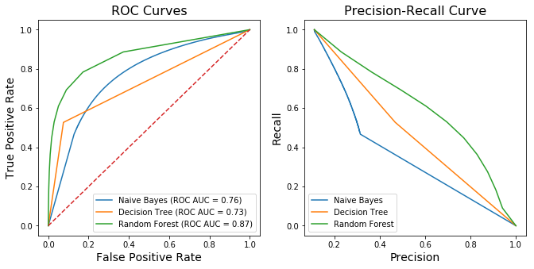
Classifying user types
Can a machine distinguish subscribers from non-subscribers based on the data?

Slide 19
User Type Classification by Machine Learning
Attempt to classify type of a rider based on the ride data
Three classifiers tested
Multinomial Naive Bayes
Decision Tree Classifier
Random Forest Classifier
Their performance scored with various metrics

Slide 20
Classification task was not easy
Classifier | Accuracy | Precision | Recall | F-score | Average Precision Score | Brier Loss
Multinomial Naive Bayes | 0.819 | 0.307 | 0.497 | 0.380 | 0.426 | 0.181
Decision Tree | 0.880 | 0.469 | 0.527 | 0.496 | 0.524 | 0.120
Random Forest | 0.923 | 0.770 | 0.448 | 0.567 | 0.645 | 0.063
They were calling back only ~50% of all the non-subscribers (Recall)
Out of riders classified as non-subscribers, ~23~70% of them were actually not (Precision)
They could possibly improved if more extra information were added

Slide 21
Predicting the Daily Ridership

Slide 22
Predicting the Daily Ridership
Being able to predict daily ridership helps the operation
Know where the demand is on a given day
Know which stations require attention
Useful for redistribution of bikes
Can plan ahead for maintenance
Dataset was split into “past” and “future”
Regression model was trained on “past” and tested on “future”
Long term and short term forecasting attempted

Slide 23
Some more details
Pilot analysis to determine the cutoff day for “past” and “future”
Only subscriber data used (they are ~90% of the ridership)
Long Term Forecasting:
Prediction made for all the days following the cutoff day
Potentially more difficult (higher uncertainty)
Short Term Forecasting:
Predictions made for 10 and 30 days following the cutoff day
Potentially easier than the long term forecasting
Two stations were closely examined as examples

Slide 24
A little bit more details on the two stations
Pershing Square North:
RIght next to the Grand Central Station, one of the biggest transportation hubs in the Northeast.
Ranked 1st in terms of usage by the subscribers
Union Square (17th St)
One of the major subway hubs with many lines crossing
A popular place in NYC for its proximity to various venues, such as restaurants and schools
Many events often held in the square.

Slide 25
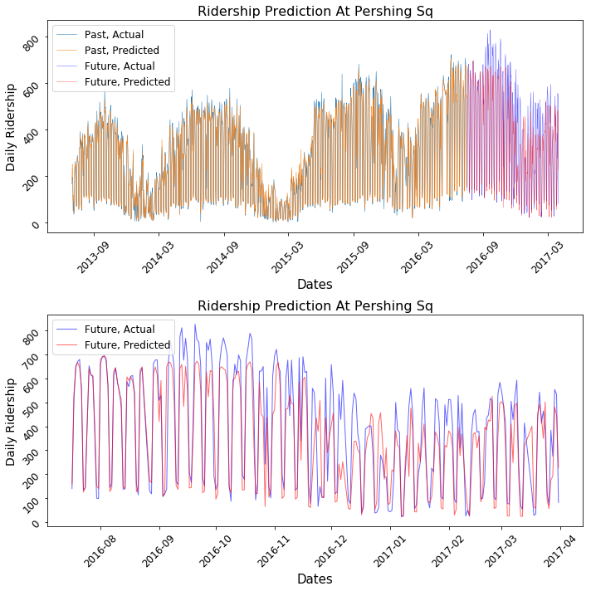
Long Term Forecasting @ Pershing Sq.
Big fluctuation between weekdays and weekends were well reproduced
Reproduces the seasonal pattern reasonably well
Could not predict jump in ridership in the later half of 2016

Slide 26
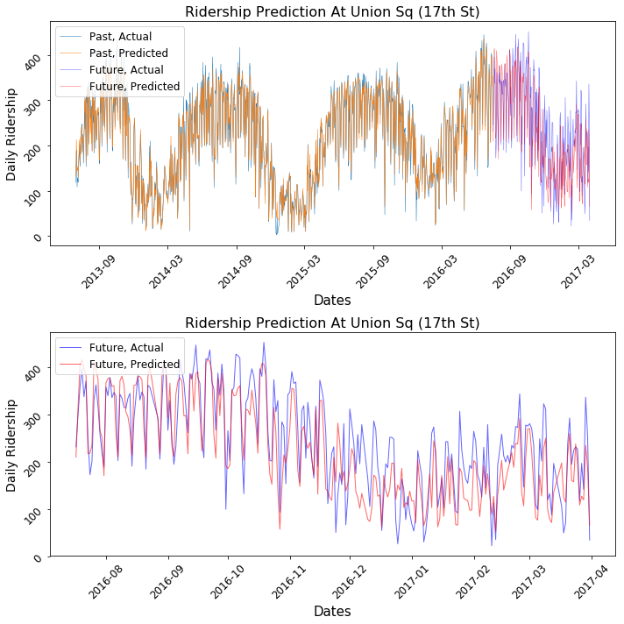
Long Term Forecasting @ Union Sq.
Smaller fluctuations between weekdays and weekends compared to Pershing Sq. were well reproduced
Reproduces the seasonal pattern reasonably well
Forecasting seems better than that at Pershing Sq.

Slide 27
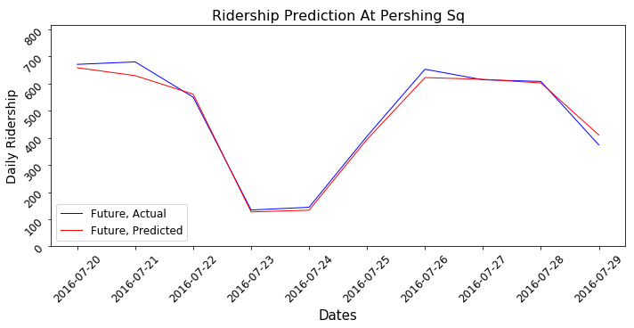
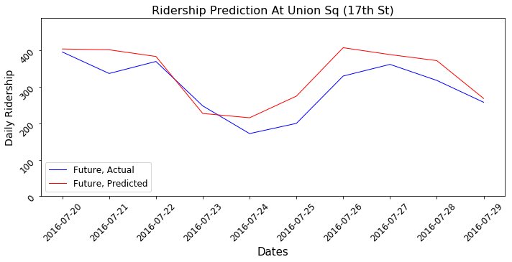
10-day Forecasting
Ridership forecasting at Pershing Sq. was near perfect
One at Union Sq. was slightly off, but still reproducing the basic pattern
Overall deviation from the actual was smaller than that of long term (as expected)

Slide 28
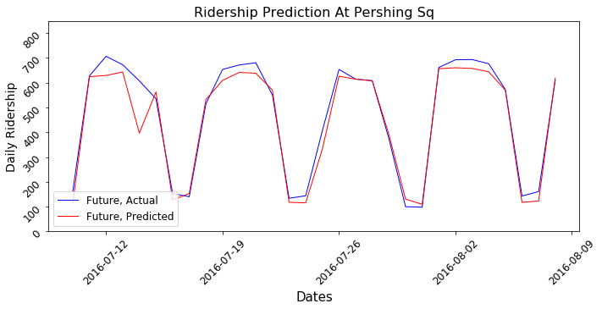
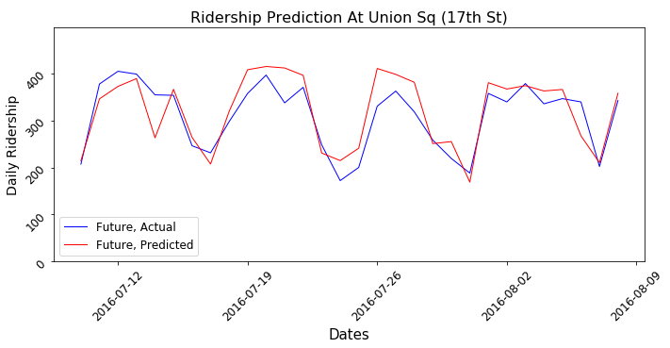
30-day Forecasting
Ridership forecasting at both stations appear very good.
Again, nearly perfect prediction at Pershing Sq. and very close forecasting at Union Sq.

Slide 29
Ridership Prediction Summary
Long term prediction could be done reasonably well
Could not predict the jump in ridership in 2016, but predictive capability is expected to go up as more data is accumulated for training the model
Seasonal and weekly patterns were well recapitulated.
Short term predictions were even better than long term one
Daily ridership can be predicted for 10 and 30 days into the future very well (>90% of varaince could be accounted for!)
They also reproduced location specific patterns (e.g. difference between Pershing Sq. and Union Sq.)

Slide 30
Highlights of This Report
Distinct ridership patterns
Seasonal pattern
Gender differences
User type differences
Factors that affect ridership were explored
Bike station locations
Weather
Classification of user type from ride data
Forecasting future daily ridership
Long term and short term predictions

Slide 31
Suggested use of this report
Better understanding of how riders use the Citibike Service
City Government and Police Department have better idea about the biker traffic in the city
Example1: user type difference can be key to make a plan for different locations
Example2: analyses conducted here can be used to reassess the location of stations or plan for a new one.
Use the forecasting model to predict daily usage, especially for short term
Useful for redistribution of bikes
Useful for planning bike removal for maintenance
Useful for seasonal planning

Slide 32
Future Research
Improve user type classification
Improve daily ridership prediction
Optimize operation based on the ridership predictions

Slide 33
Acknowledgements
Andrew Vaughan
Springboard

Slide 34
Thank You!

Slide 35
Extra Info: User Type Classification

